Slide 1


Home
Photo
About Us
Contact
Feasibility
Study
Document
Haat Baran
Presented By
Mostofa Hasin Mahdi
223071109
Talal Sharar Apurbo
223071108
31st Batch, Group - (A)
Dept. of CSE

Slide 2



Haat Baran
THE PROBLEM
In Bangladesh, many citizens live below the poverty line, unable to access capital, financial services, or digital platforms. Despite their potential and determination, these individuals struggle to start small businesses due to a lack of funds and formal identification. Traditional donation systems often lack transparency, leading to misuse of funds and discouraging potential donors.

Slide 3


Haat Baran
THE NEED
There is a growing necessity for a trusted, technology-driven funding system that allows the underprivileged to seek genuine financial assistance while ensuring transparency for donors. The system must verify applicants through field visits and biometric data collection since most of them are illiterate and do not possess government-issued identification.

Slide 4
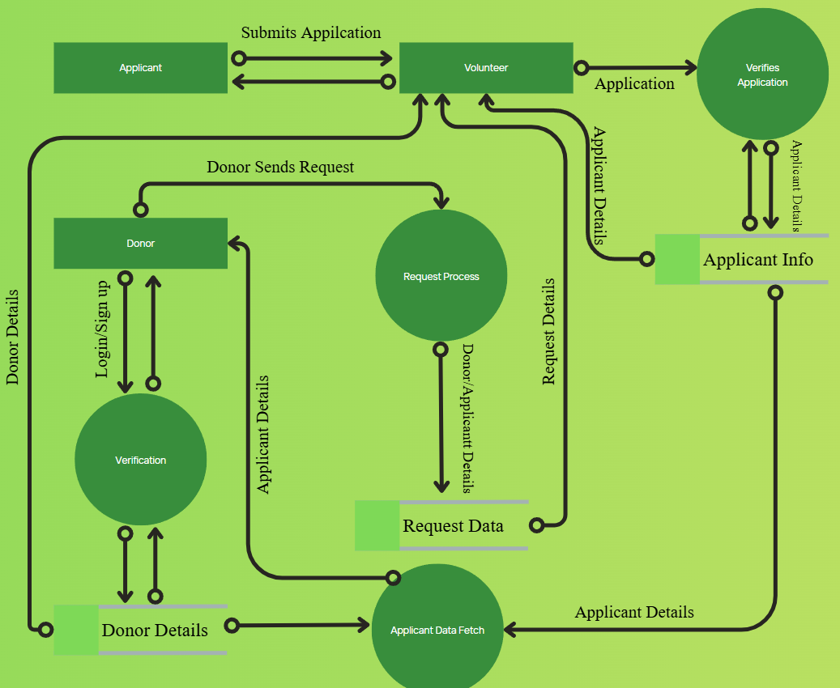
DFD of Proposed Software
Haat Baran

Slide 5

Haat Baran
Different Alternatives
To solve the problem we have proposed 3 alternative systems.
Alternative 1: Community Funding Through Local NGOs
Alternative 2: Physical Donation Drives and Local Verification
Alternative 3: Digital Platform Haat Baran App

Slide 6
Haat Baran
Selecting Alternative 3
All of the alternatives are technically and operationally feasible to some extent. However, based on the economic analysis, we have found that Alternative 3 (Haat Baran App) is the most cost-effective, efficient, and sustainable solution compared to the other two

Slide 7
Alternative 3
Haat Baran
Investment Table
Serial no | Particular | Cost(BDT)
1 | Systems (Server + Database + Basic Workstations) | 70,000
2 | Personel Cost (Designer, Developers, Project Manager) | 1,00,000
3 | DBMS | 50,000
4 | Marketing Cost | 40,000
5 | Administrative Cost | 40,000
 | Total | 3,00,000
Cost/ Benefit Table
Particular | Amount | Particular | Amount
Maintenance Cost | 50,000 | Funding support to 8 communitites | 8 x 12 x 4500 = 4,32,000
Additional Cost | 30,000 | Improved efficiency & digital reach | 80,000
Total | 80,000 | Total | 5,12,000
Cost
Benefit

Slide 8
Alternative 3
Haat Baran
Cost/ Benefit Table per year basis
Year | Saving | Present Value (20%) | Cumulative Value
1 | 4.32 | 0.83 | 3.59
2 | 4.32 | 0.69 | 6.57
3 | 4.32 | 0.58 | 9.08
4 | 4.32 | 0.48 | 11.15
5 | 4.32 | 0.40 | 12.88
6 | 4.32 | 0.33 | 14.31
7 | 4.32 | 0.28 | 15.52

Slide 9

Haat Baran
Thank You

